Slide 2
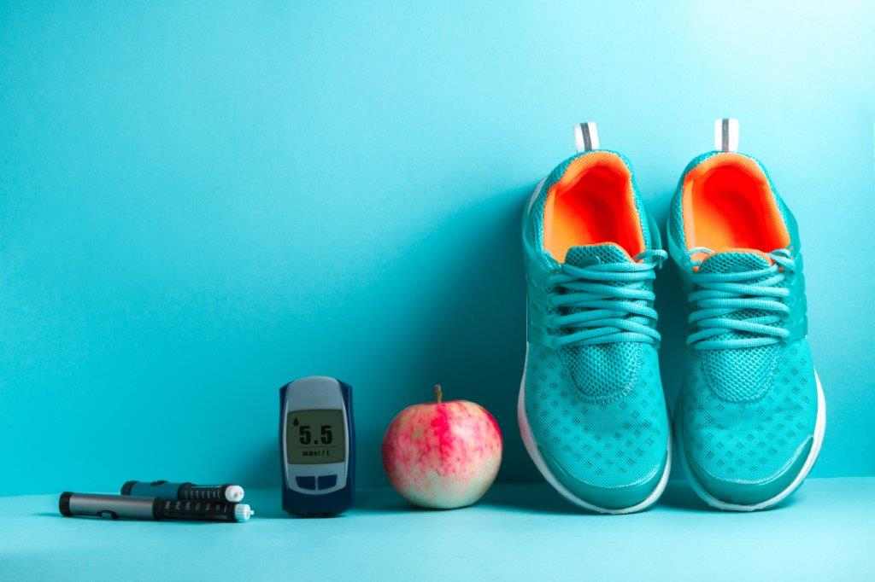
SELF IMAGE,
SELF ESTEEM, IDENTITY
SCHOOL AND EDUCATION
TRANSFER TO ADULT CARE
????
PHYSICAL ACTIVITY
RELATIONSHIPS, SEXUALITY, CONTRACEPTIVES
FRIENDS AND SPARE TIME
ALCOHOL, TOBACCO, DRUGS
DIET
DIABETIES
TREATMENT
Notes:
Here’s a more diagnosis-specific example of the concept map focusing on diabetes.
These can be used both during the HEADS interview and in general conversations to approach different discussion areas.

